Slide 1
Identifying Habitable Exoplanets using Machine Learning
BBM467 Data Intensive Applications
Data Science Capstone Project
Hikmet Güner 21946179 – Deniz Erkin Kasaplı 21946328

Slide 2
Problem
Filtering exoplanets by clustering them by their attributes in order to increase efficiency of habitable planet search

Slide 3
Problem
Considering even the closest planets outside of the solar system are unreachable, there is no way to classify a planet as habitable or not with accuracy. However, there are some key elements which are considered necessary for habitability. The aim of this project is to gather insight of how grouping planets, without making any habitability inducing calculations, could affect filtering based on habitability. The dataset used for this project is directly fetched from NASA's exoplanet archive, which will be clustered for further analysis. The results could be utilized to filter out false positives, saving time and resources which would be spent on those planets otherwise.

Slide 4
Data Understanding

Slide 5
Data Understanding
The dataset used is directly from NASA's exoplanet archive, which the user "SATHYANARAYAN RAO" has compiled and created a comma-separated value (.csv) version of it. The dataset could be reached from the link https://www.kaggle.com/datasets/sathyanarayanrao89/nasa-exoplanetary-system

Slide 6
Data Understanding
The data contains a lot of fields used for labelling, which is not within the interest of the project. A lot of information about the host star of the system is present, which could be used for further analysis, however, due to scope of the project being focused solely on the attributes of the planets, they possess no use for the project. There also exists some columns with no suitable definitions found.

Slide 7
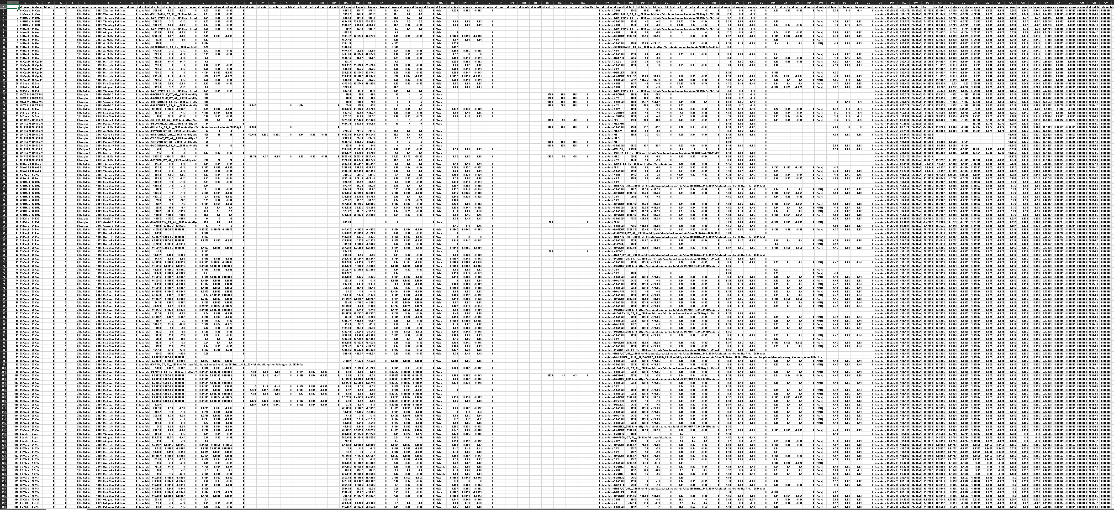

Slide 8
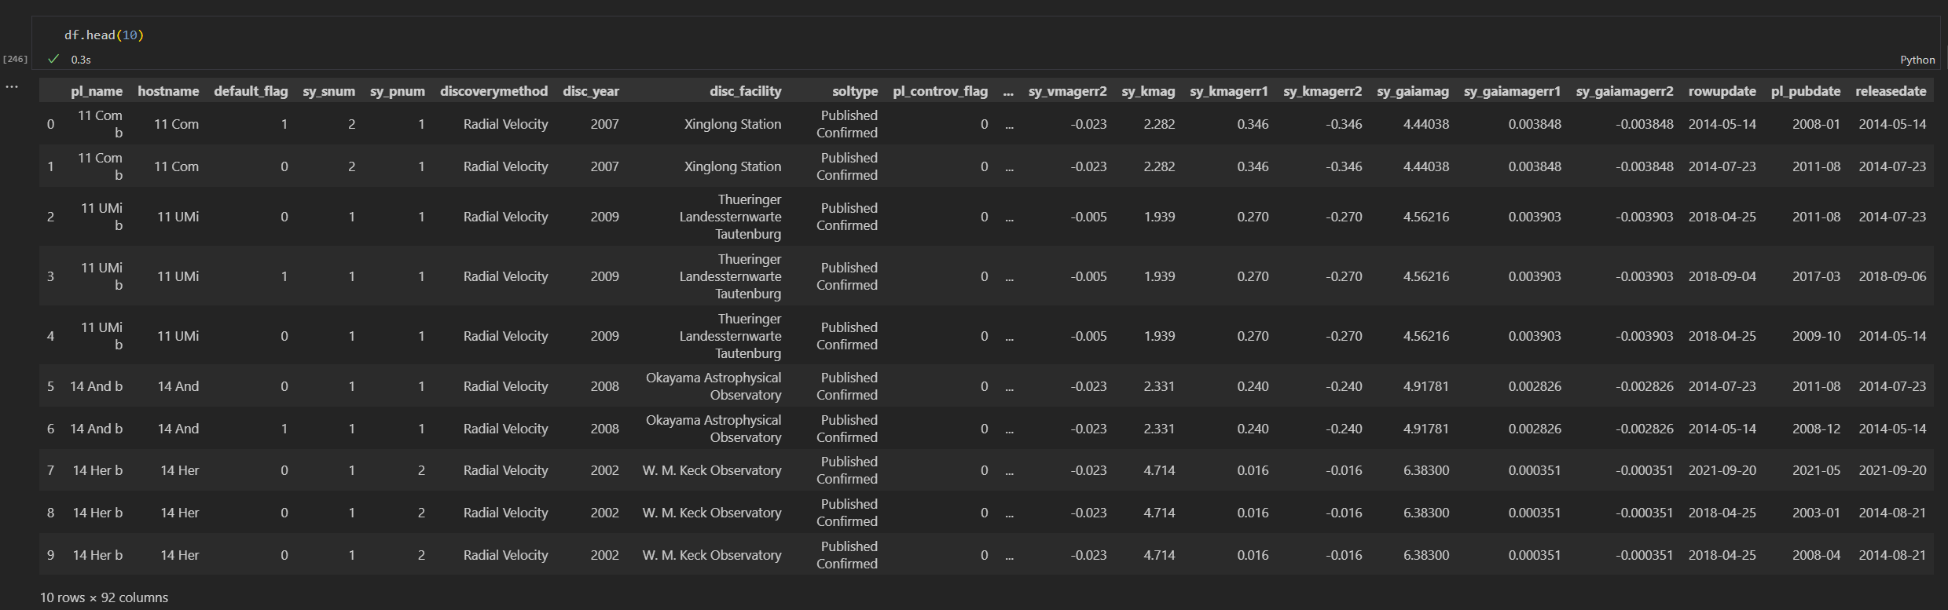
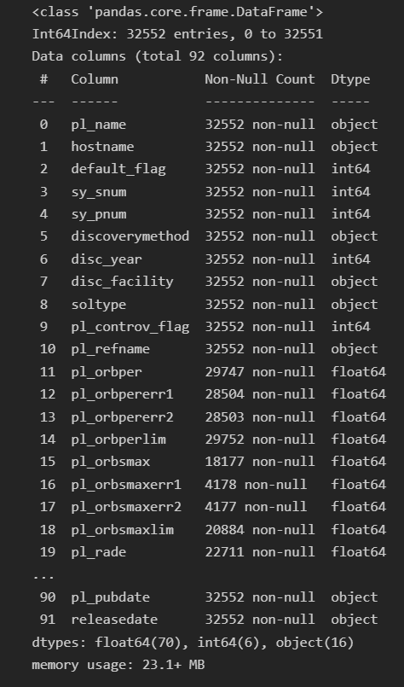
Help?

Slide 9
Data Understanding
As you can see, even with the help of pandas we cannot make sense of the data
Thus, it is time for us to roll up our sleeves and research each column manually

Slide 10
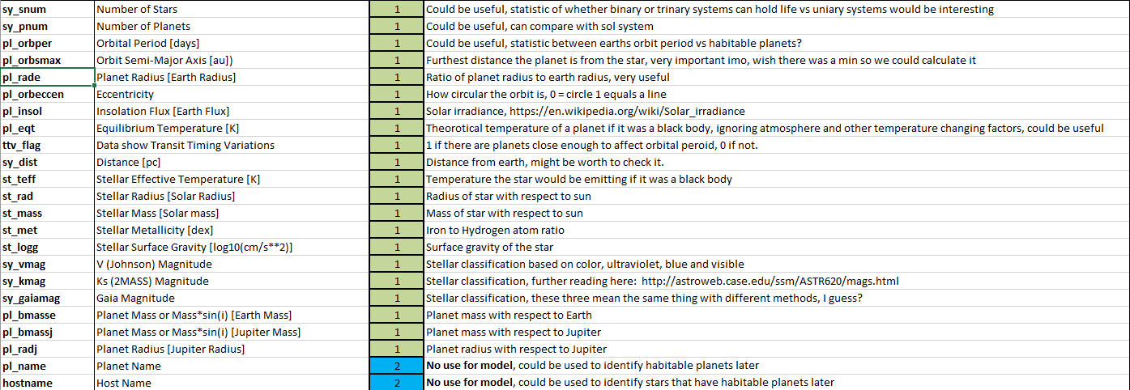

Slide 11
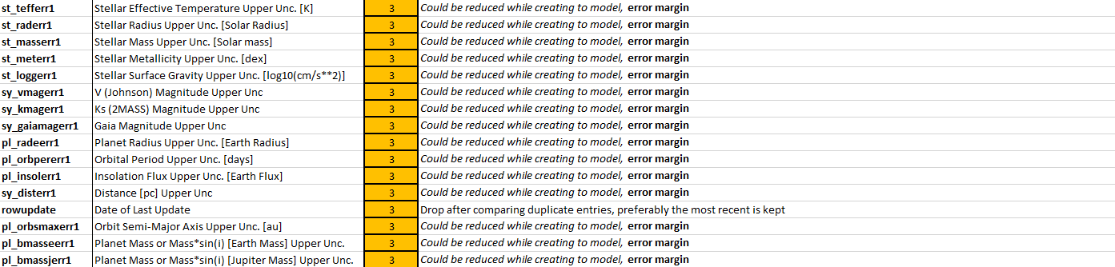

Slide 12
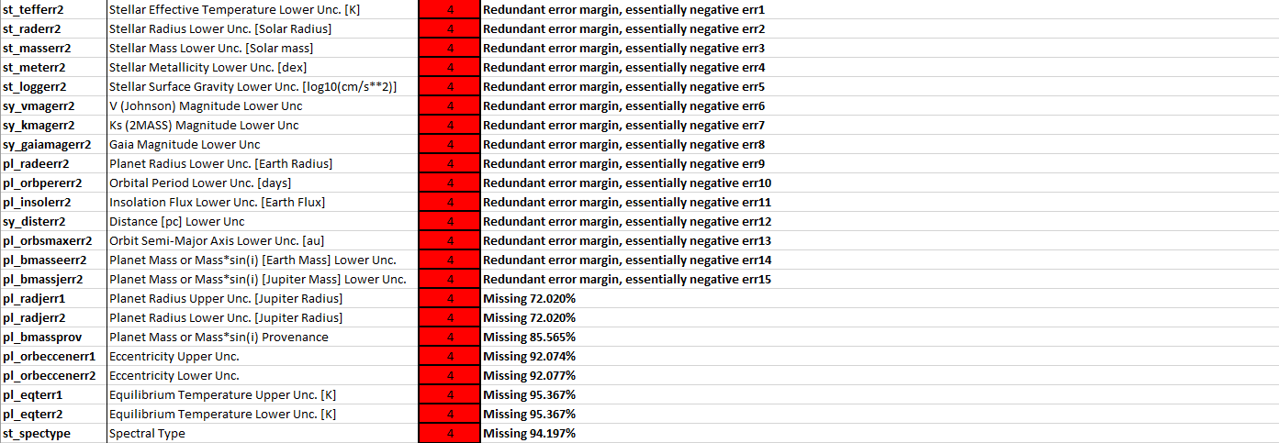
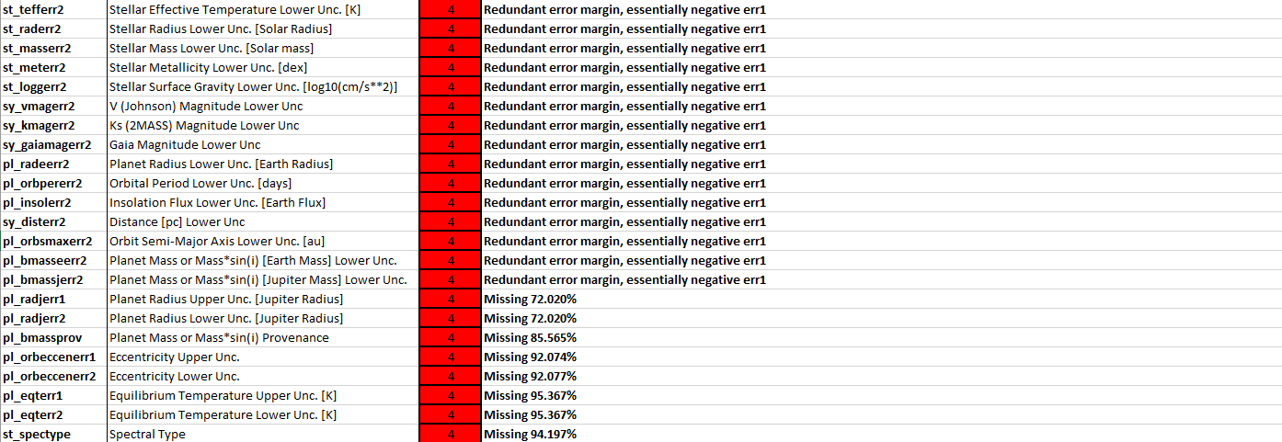

Slide 13
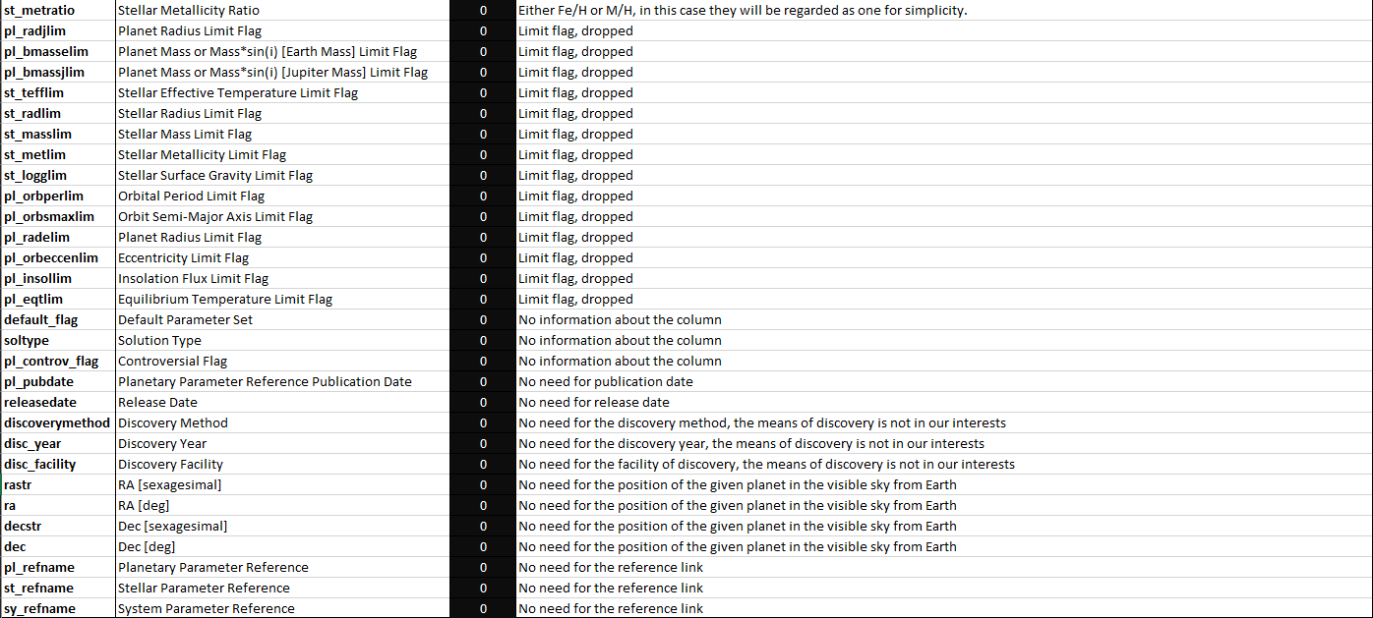

Slide 14
Data Preparation
There are so many columns in our data which we will not use. Also, we need to deal with many missing values.

Slide 15
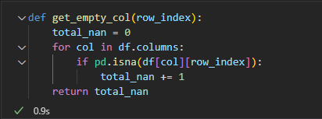

Data Preparation
For data preparation we started with dropping the rows missing over 50 columns. Although we will use Imputation in the following steps rows missing over 50 columns wouldn’t lead us to true conclusions.

Slide 16
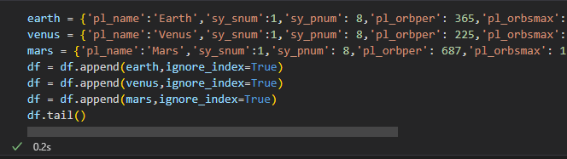
Data Preparation
Next step would be adding Earth, Mars and Venus to our dataframe because we also want to show them in clustering to see where they stand at.

Slide 17
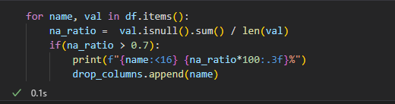
Data Preparation
Now it’s time to deal with the columns with many missing data. Since, it will be inefficient to fill the missing values if a column has many missing values, we decided to drop columns which have more than 70% missing data.

Slide 18
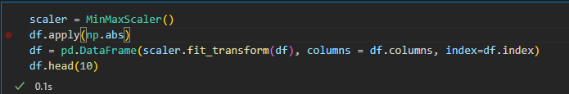
Data Preparation
Now we can start filling the empty data. We will fill the columns which have missing values lower than 70%. However, before start filling the data we wanted to scale the data, using absolute function to prevent negative error margin values from impacting scaling. Also we analyzed each column.

Slide 19
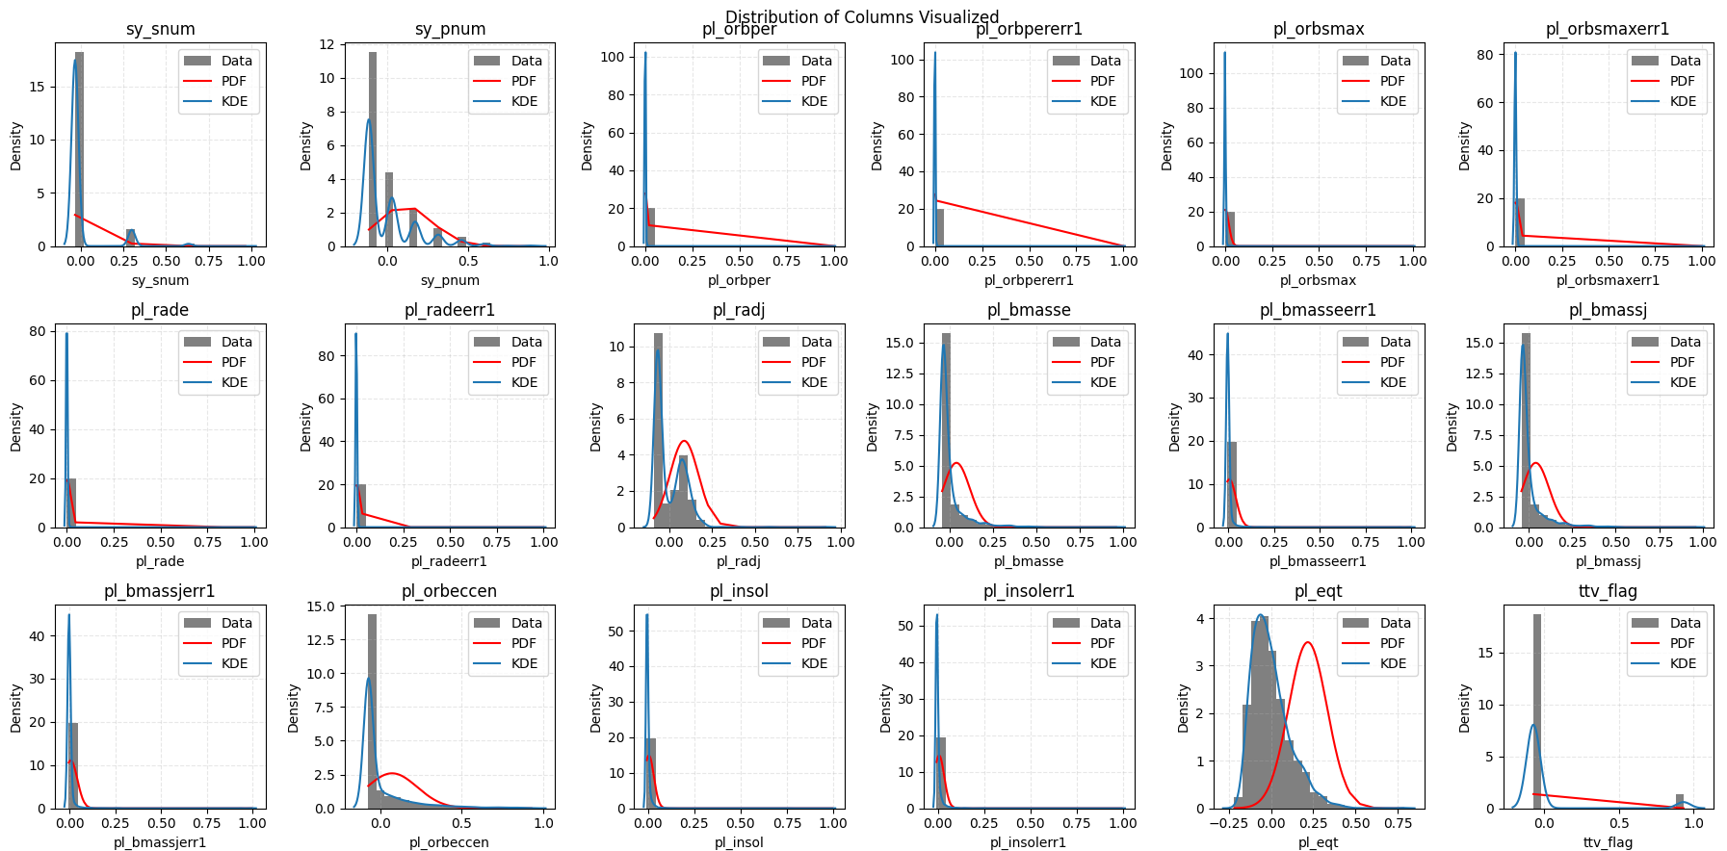
Data Preparation

Slide 20
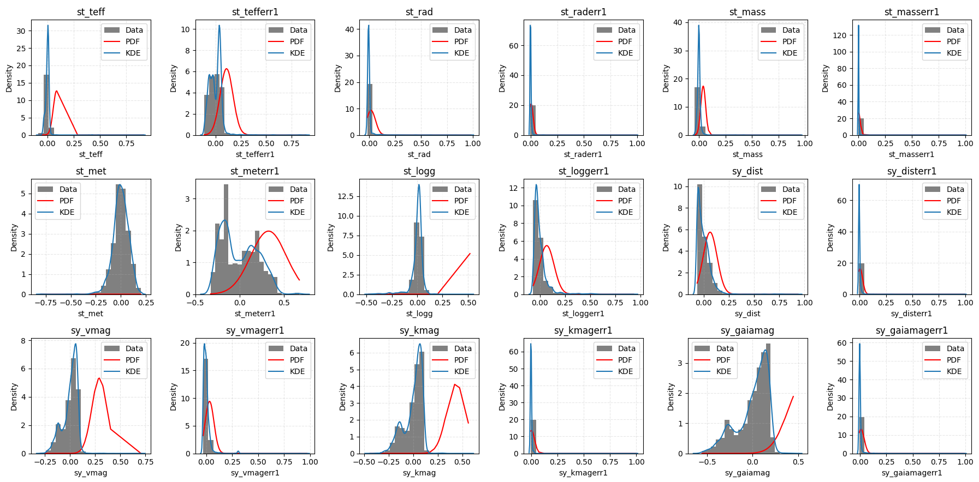
Data Preparation

Slide 21
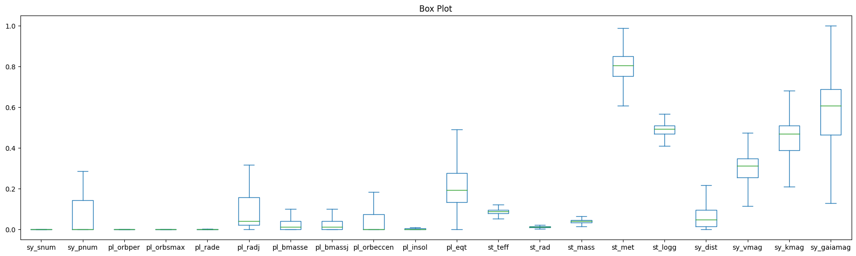
Data Preparation

Slide 22
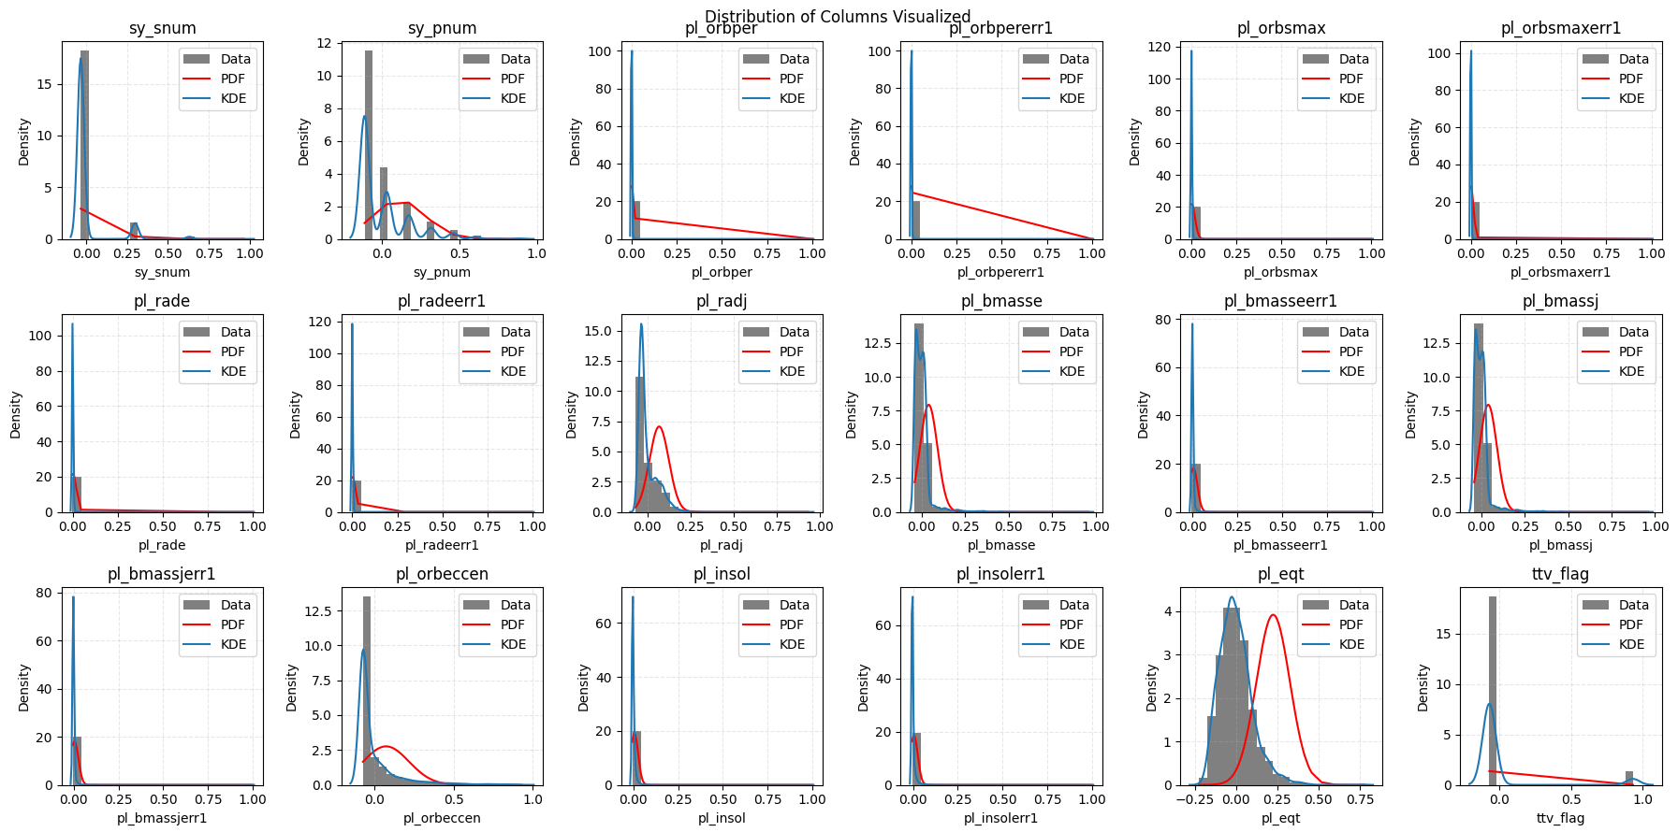
Data Preparation
Plotting each column after KNN Imputer

Slide 23
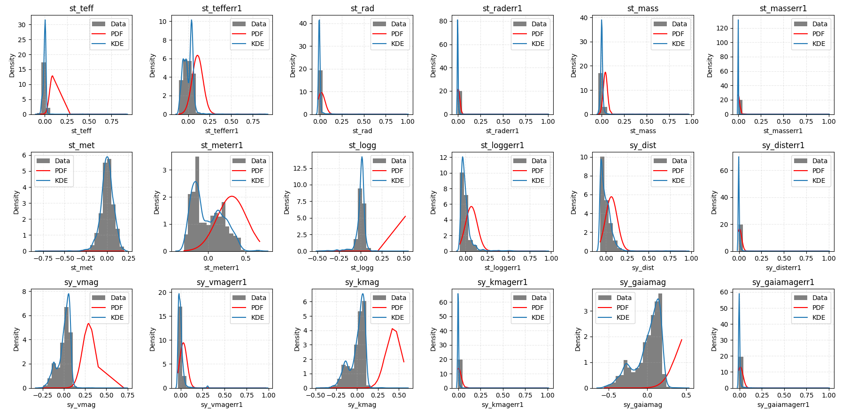
Data Preparation

Slide 24
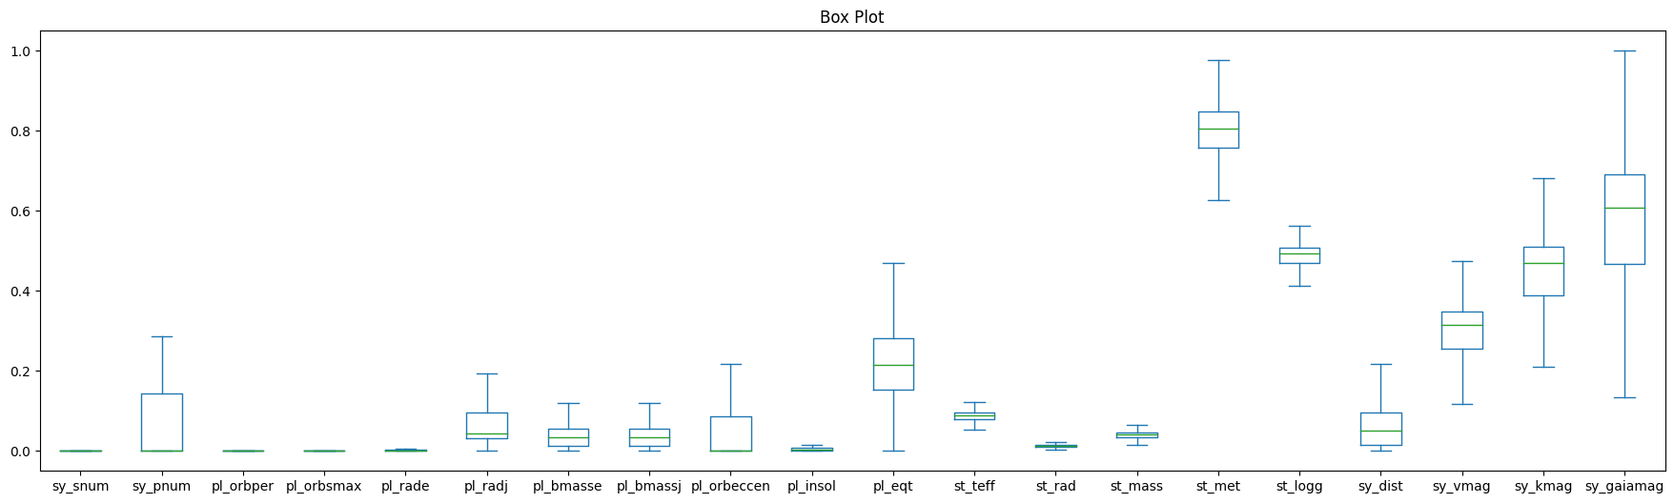
Data Preparation

Slide 25
Data Preparation
In order to make real assumptions about if a planet is habitable or not, you first need to calculate if it is in the habitable zone or not.
The definition of “habitable zone” is the distance from a star at which liquid water could exist on orbiting planets’ surfaces. Habitable zones are also known as Goldilocks’ zones, where conditions might be just right – neither too hot nor too cold – for life.

Slide 26

Data Preparation
To calculate Habitable zone we first calculated the luminosity of the stars
With using Luminosity we calculated the minimum and maximum distance that habitable zone can have

Slide 27
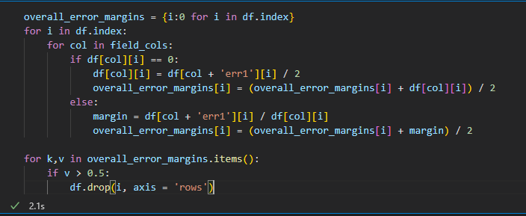
Data Preparation
Now we need to deal with error margins. We check individual rows and drop whose total error margin is above 50%. Also, we deal with the special case is where metallicity is 0, it must not be zero thus half of the error margin is added to the value in order to fix the problem.

Slide 28
Modeling

Slide 29
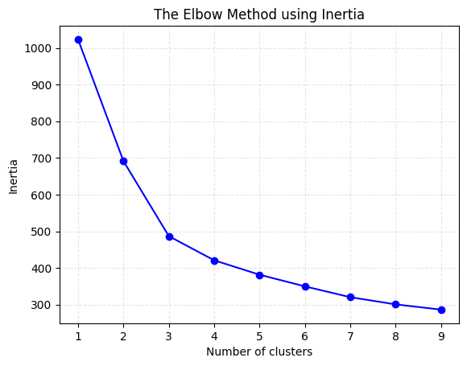
Modeling
In order to start modeling we first needed to check optimal number of clusters to use. Thus, we calculated inertias.

Slide 30
Modeling
Before clustering we used Principal Component Analysis (PCA) in order to be able to visualize our clustering in 2D plots.
PCA forms the basis of multivariate data analysis based on projection methods. The most important use of PCA is to represent a multivariate data table as smaller set of variables (summary indices) in order to observe trends, jumps, clusters and outliers.

Slide 31
Modeling
In our models we used KMeans clustering. For the first clustering which we clustered according to all columns that we obtained after data preparations, we used Hierarchical clustering. We used 2 clustering methods because we wanted to validate our outcomes with using rand score. After applying clustering methods to all columns at once, we clustered the planets according to only planet columns. We also used only stellar information.

Slide 32
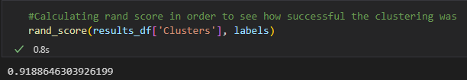
Modeling
In order to understand if the clustering is performed well we used rand score.
The Rand Index computes a similarity measure between two clusterings by considering all pairs of samples and counting pairs that are assigned in the same or different clusters in the predicted and true clusterings

Slide 33
Evaluation

Slide 34
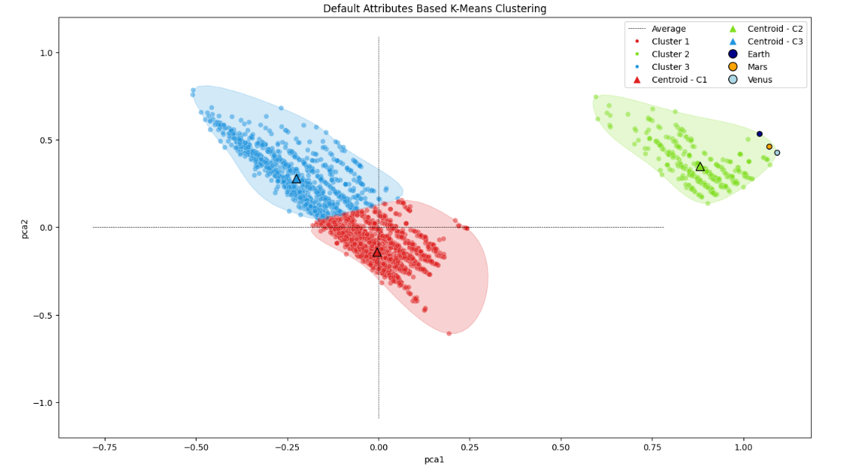
Evaluation

Slide 35
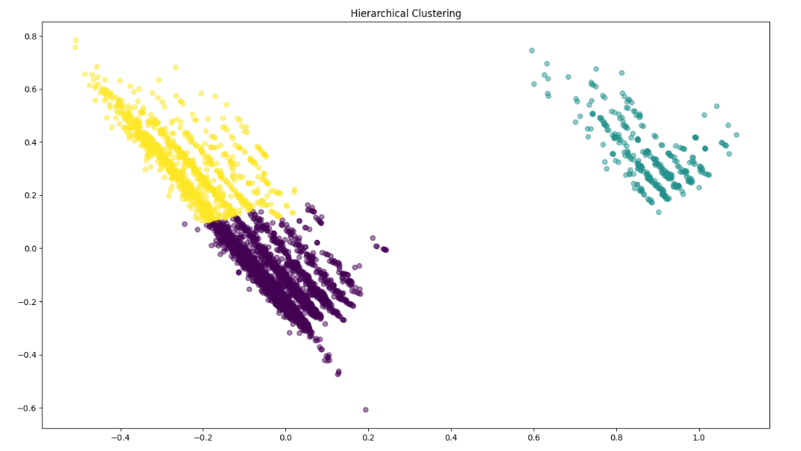
Evaluation

Slide 36
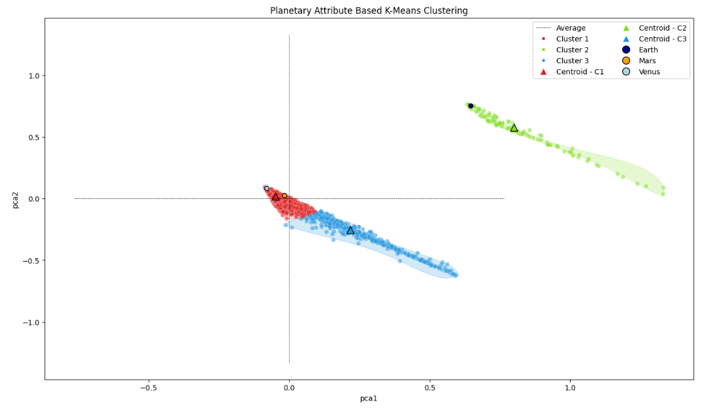
Evaluation

Slide 37
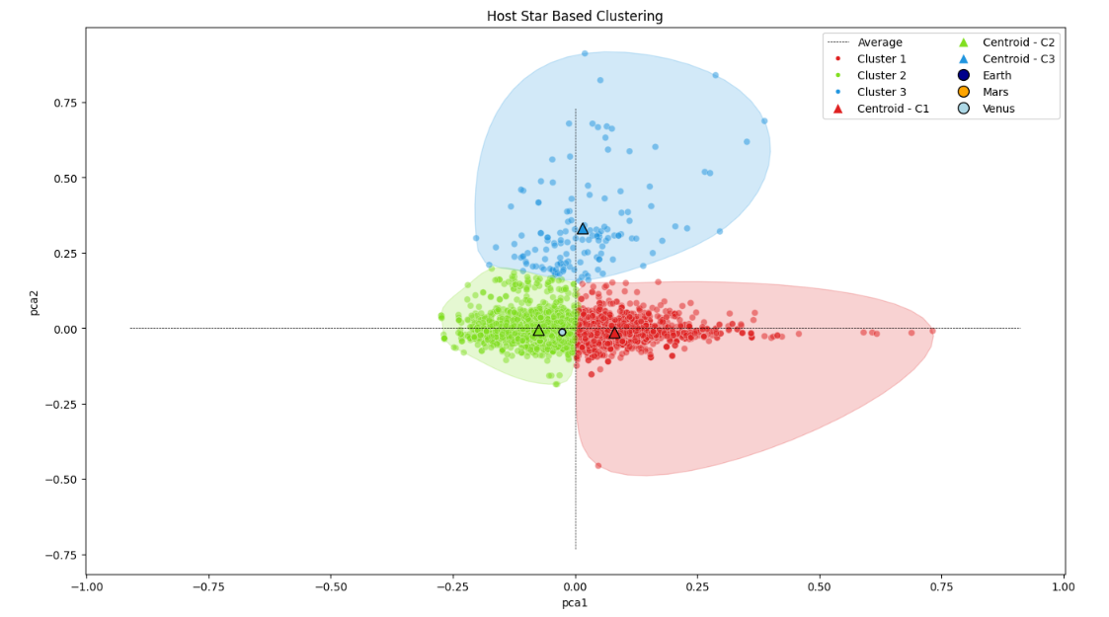
Evaluation

Slide 38
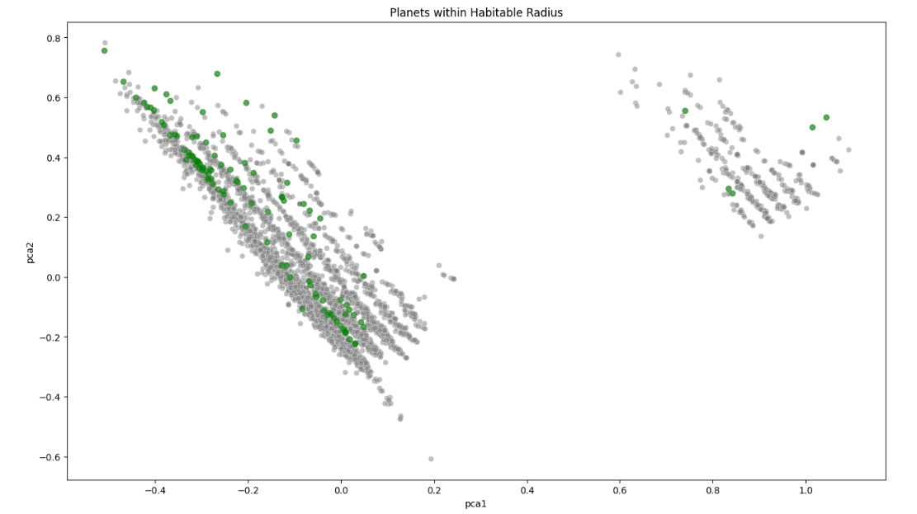
Evaluation

Slide 39
References
https://urc.ucdavis.edu/how-write-abstract - Undergraduate Research Center, How to Write an Abstract?
https://app.datacamp.com/learn/courses/unsupervised-learning-in-python - Datacamp, Unsupervised Machine Learning in Python
https://machinelearningmastery.com/probability-density-estimation/ - Probability Denstiy Function or Kernel Density Function?
https://towardsdatascience.com/probability-distribution-functions-demystified-a6e882759af3 - Understanding Probability Mass Function
https://machinelearningmastery.com/knn-imputation-for-missing-values-in-machine-learning/ - KNN Imputation in Machine Learning
https://towardsdatascience.com/how-to-find-the-optimal-value-of-k-in-knn-35d936e554eb - Optimal K value in KNN Imputation
https://educationalresearchtechniques.com/2018/10/17/kmeans-clustering-in-python/ - How to utilize the Elbow Method for Finding Optimal Cluster Size
https://chartio.com/learn/charts/box-plot-complete-guide/ - A Complete Guide to Box Charts
http://astroweb.case.edu/ssm/ASTR620/mags.html - Astronomical Magnitude Systems
https://en.wikipedia.org/wiki/Metallicity - Metallicity, Wikipedia

Slide 40
References
https://exoplanets.nasa.gov/search-for-life/habitable-zone - Habitable Zone, Nasa
https://www.atnf.csiro.au/outreach/education/senior/astrophysics/photometry_luminosity.html#:~:text=Luminosity%2C%20L%2C%20is%20a%20measure,is%20called%20its%20bolometric%20luminosity - Luminosity Calculation
https://www.bbvaopenmind.com/en/science/physics/planetary-systems-and-the-habitable-zone - Distance According to Luminosity
https://www.geeksforgeeks.org/principal-component-analysis-with-python/ - Principal Component Analysis
https://www.youtube.com/watch?v=FgakZw6K1QQ&ab_channel=StatQuestwithJoshStarmer - PCA Explained
https://www.sartorius.com/en/knowledge/science-snippets/what-is-principal-component-analysis-pca-and-how-it-is-used-507186#:~:text=Principal%20component%20analysis%2C%20or%20PCA,more%20easily%20visualized%20and%20analyzed - Why PCA Is Used?
https://www.section.io/engineering-education/clustering-in-unsupervised-ml/#:~:text=The%20main%20types%20of%20clustering,Gaussian%20Mixtures%20Model%20(GMM) - Types of Clusterings
https://www.w3schools.com/python/python_ml_hierarchial_clustering.asp - Hierarchical Clustering
https://scikit-learn.org/stable/modules/generated/sklearn.metrics.rand_score.html - Rand Score
https://www.w3schools.com/python/python_ml_scatterplot.asp - Scatter Plot

